Slide 1


Beyond Awareness: Managing Human Risk

Slide 2

Javvad Malik
Lead CISO Advisor
KnowBe4
25+ years in cybersecurity leadership
Focus: Human element & cyber mindset
Guinness World Record Setter
JavvadM@KnowBe4.com
Linkedin: /in/Javvad

Slide 3




The Evolving Risk Landscape
AI-Powered Attacks
Unprecedented scale, sophistication, and personalisation targeting human vulnerabilities
The Human Element
Primary attack vector now more exposed than ever before
Multi-Dimensional Impact
Reputational damage, financial losses, operational disruption

Slide 4

60%+
of all breaches involve a human element
The uncomfortable truth every C-suite executive must confront

Slide 5
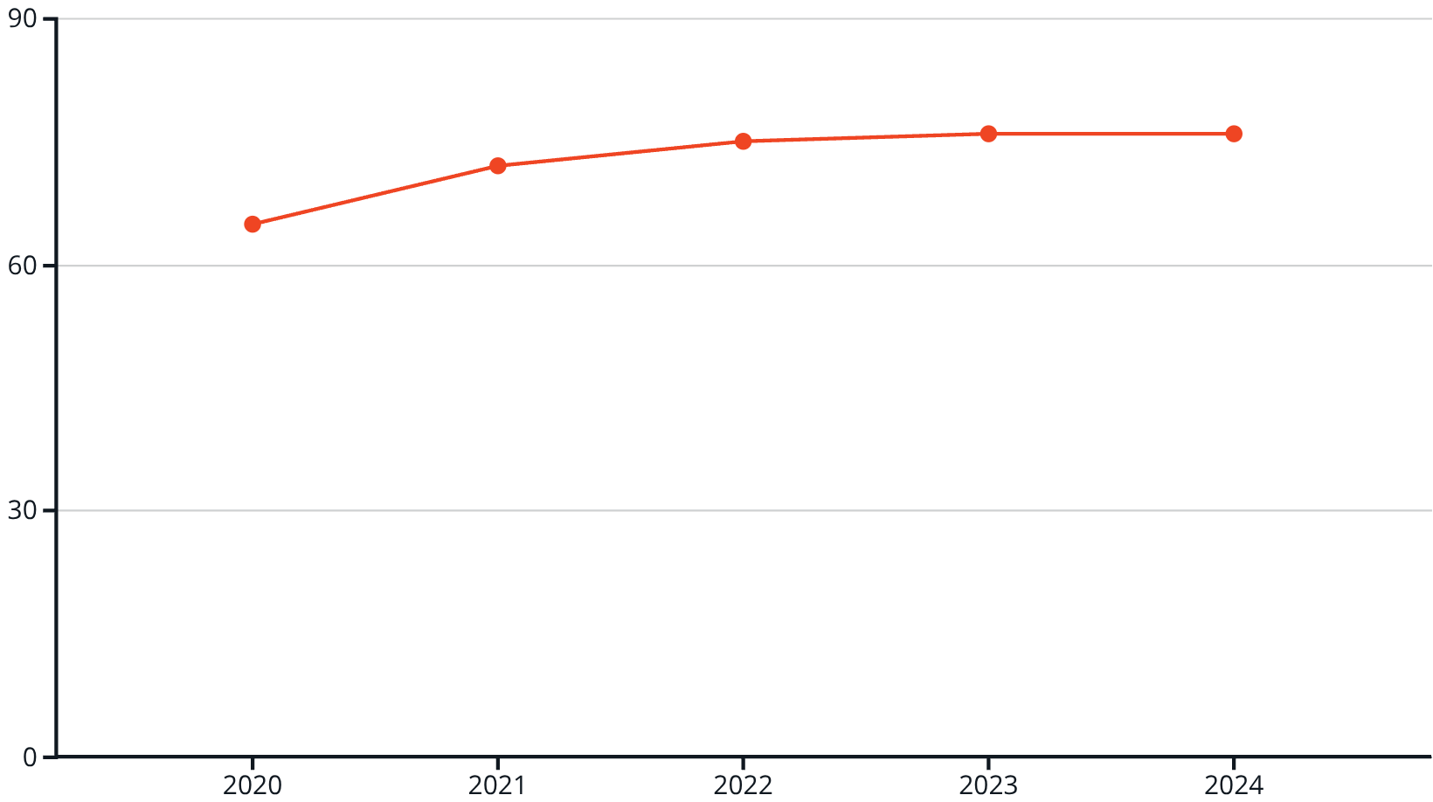
The Security Plateau
The Challenge
Traditional tools: essential but insufficient
Isolated awareness programmes hit ceiling
Building higher walls whilst inviting threats through the gate

Slide 6
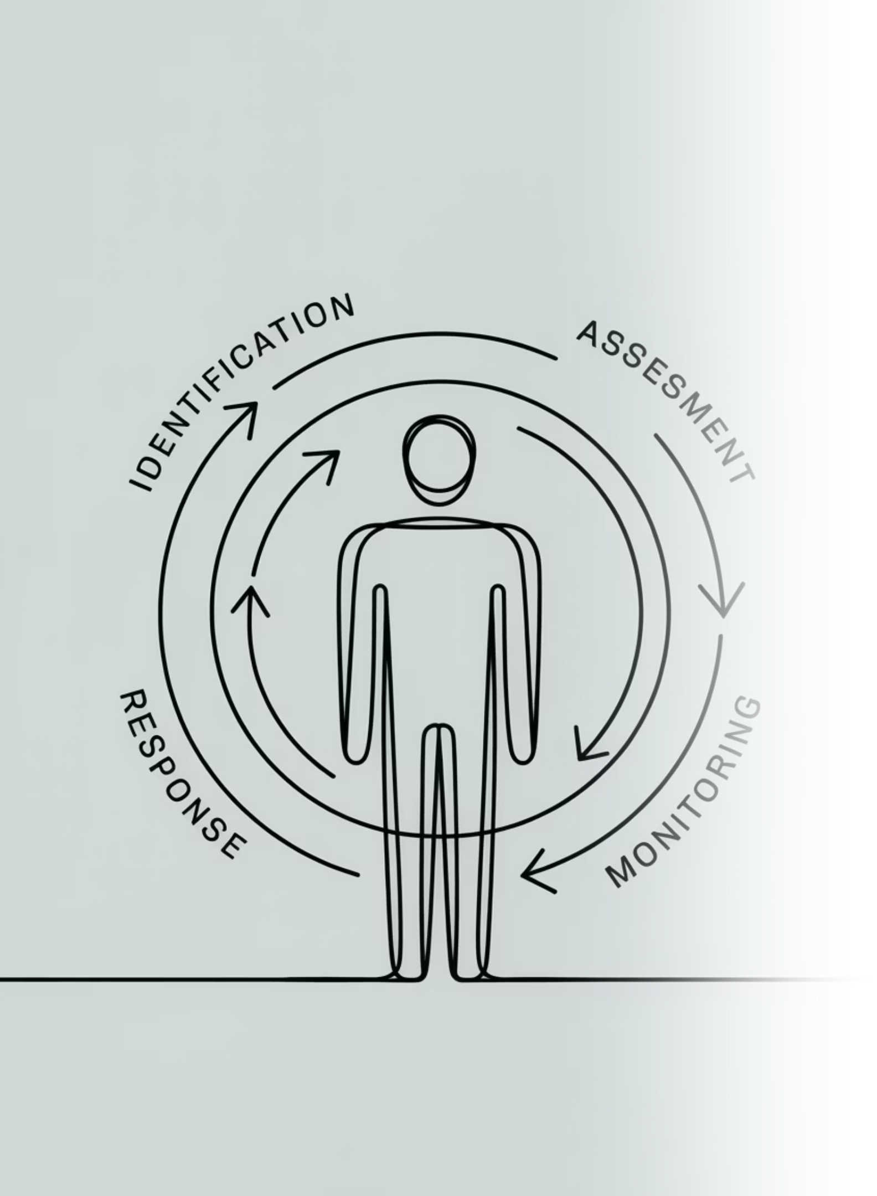
Human Risk Management (HRM)
Strategic. Data-Driven. Measurable.
A comprehensive approach to identify, measure, and mitigate human-derived risk across the enterprise

Slide 7

"All models are wrong, but some are helpful."
— George E.P. Box

Slide 8








The DEEP Framework for Human Risk
Defend
Limit attacks that your workforce is exposed to
Educate
Raise awareness for cyber threats among your workforce
Empower
Foster positive security culture
Provide agency
Protect
Limit fallout from mistakes

Slide 9
Social engineering
Users targeted by external attackers
Accidental insiders
Genuine mistakes
Convenience bypassers
Trading security for efficiency
Malicious insiders
Users with harmful intent
Defend
Limit attacks that your workforce is exposed to
Educate
Raise awareness for cyber threats among your workforce
Empower
Foster positive security culture
Provide agency
Protect
Limit fallout from mistakes

Slide 10
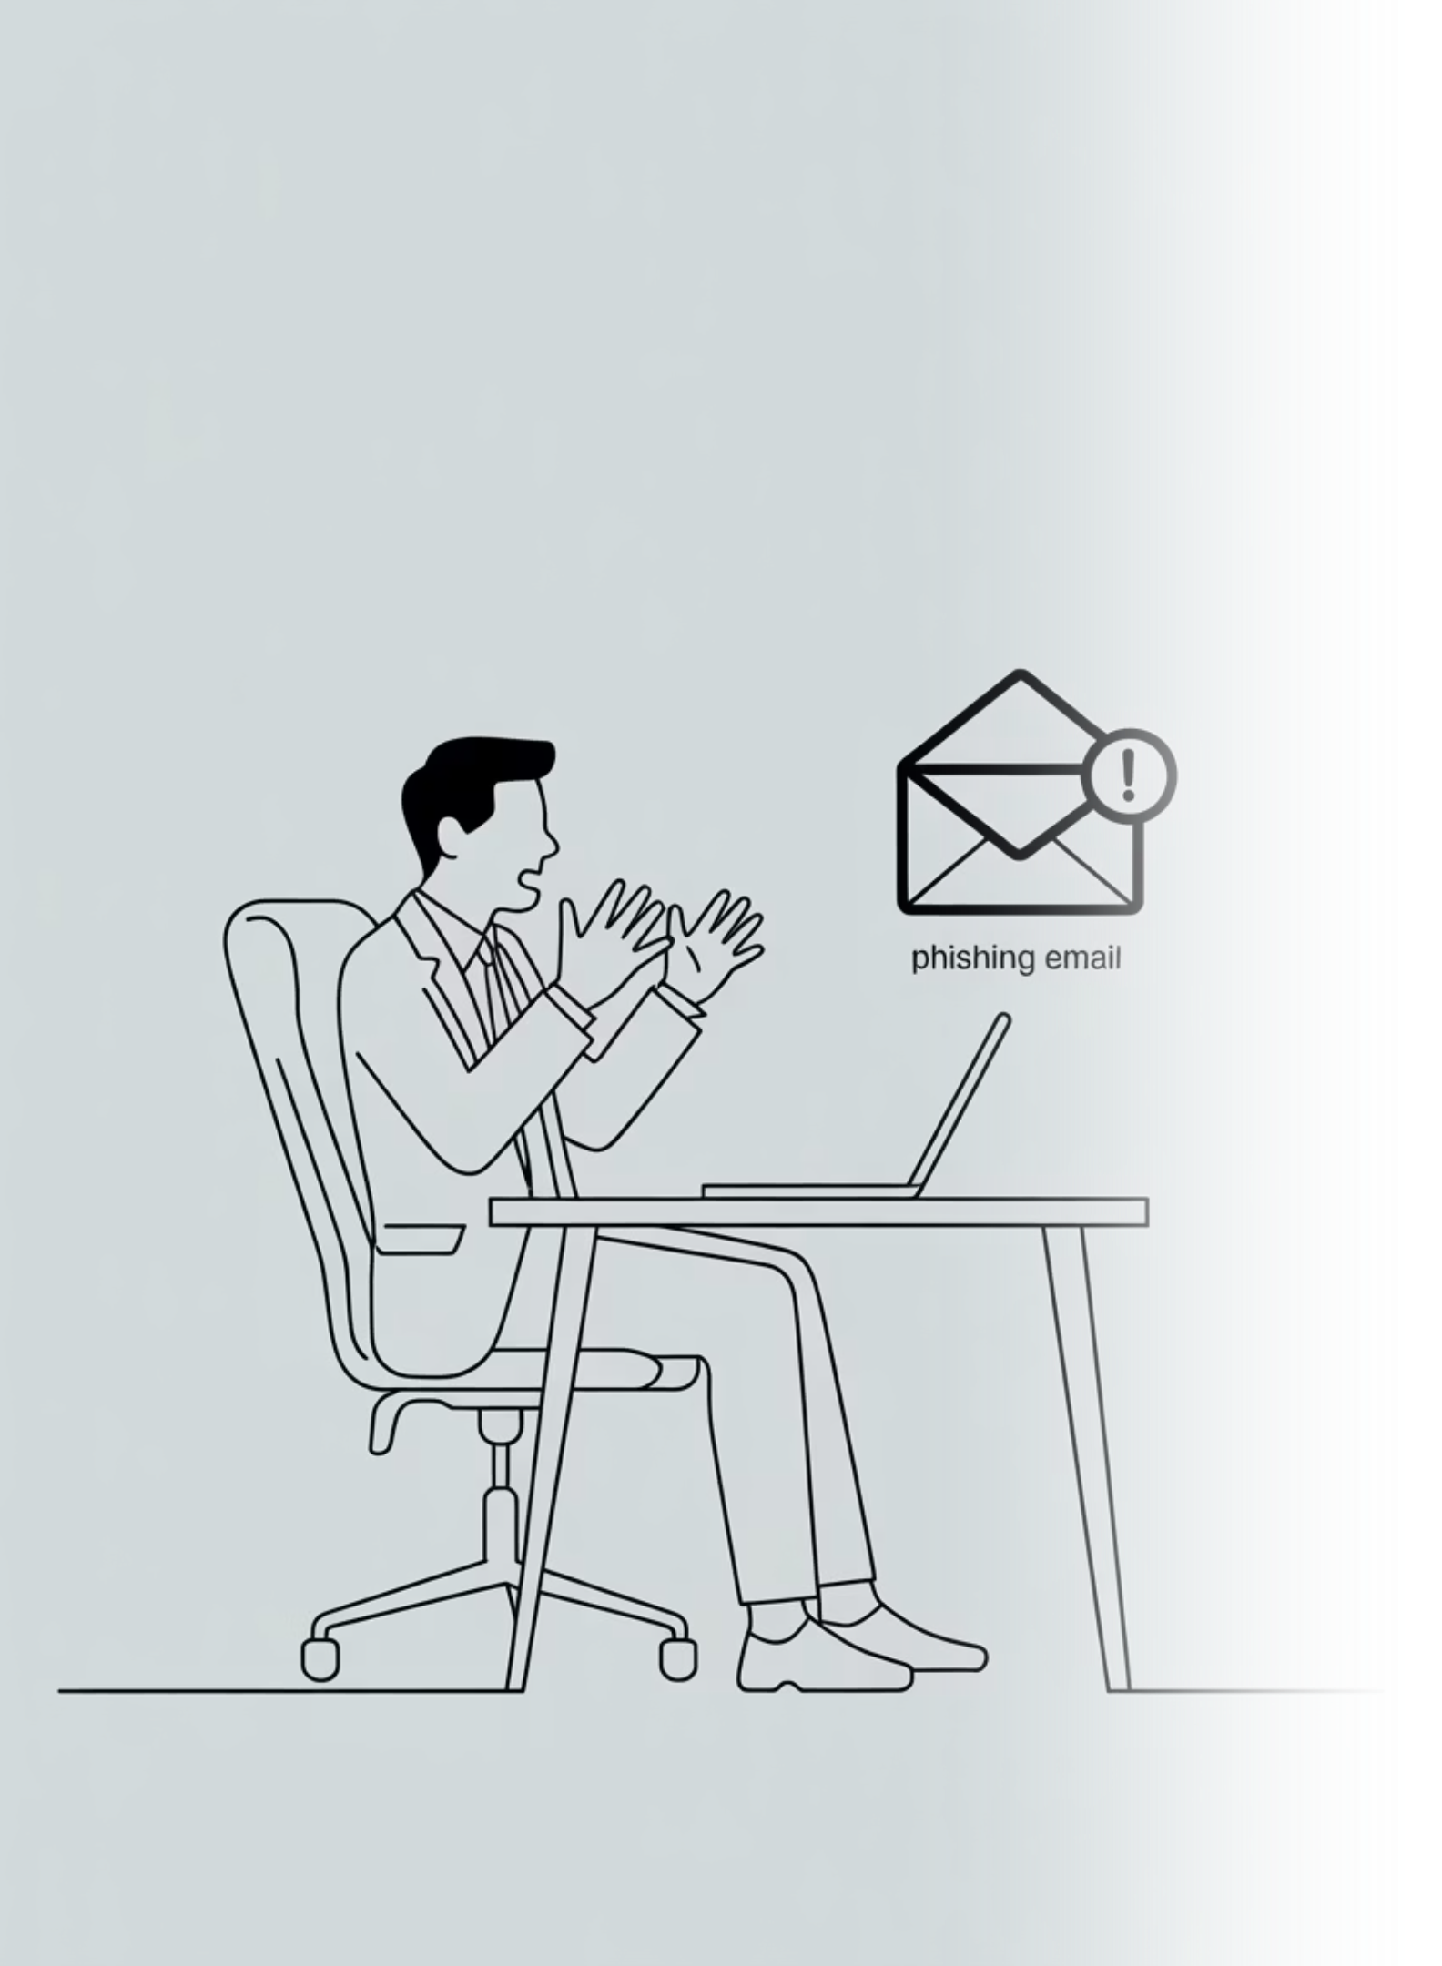

DEEP Matrix: Worked Example Scenario
Users are choosing weak passwords: How do we apply the DEEP framework?

Slide 11
Social engineering
Users targeted by external attackers
Accidental insiders
Genuine mistakes
Convenience bypassers
Trading security for efficiency
Malicious insiders
Users with harmful intent
Scan Dark Web
Crack AD
Defend
Limit attacks that your workforce is exposed to
Educate
Training modules
Nudges
Raise awareness for cyber threats among your workforce
Empower
Password Manager
SSO
Foster positive security culture
Provide agency
Protect
Account monitoring
MFA
Limit fallout from mistakes

Slide 12
Social engineering
Users targeted by external attackers
Accidental insiders
Genuine mistakes
Convenience bypassers
Trading security for efficiency
Malicious insiders
Users with harmful intent
Defend
Limit attacks that your workforce is exposed to
Educate
Raise awareness for cyber threats among your workforce
A Human Risk Management Toolkit
Empower
Foster positive security culture
Provide agency
Protect
Limit fallout from mistakes

Slide 13
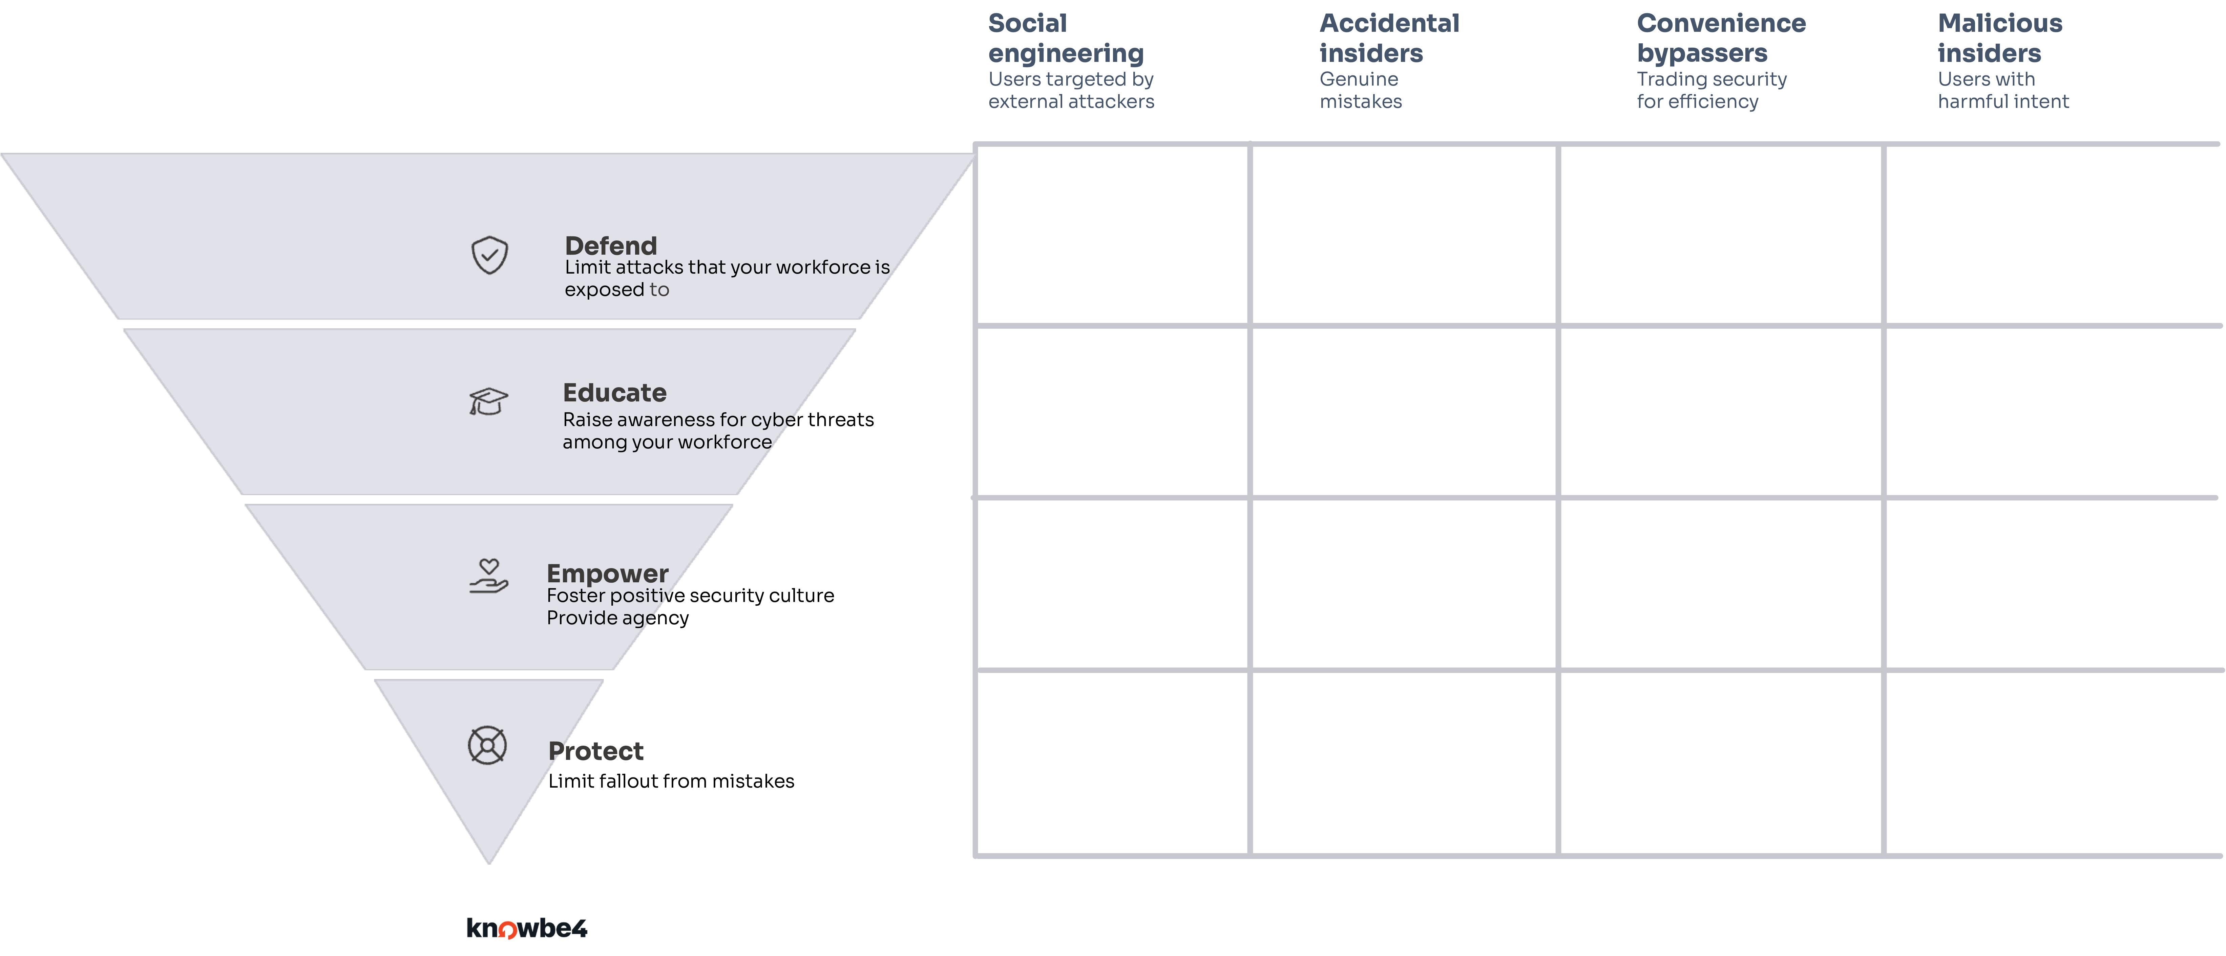
The Power of the Matrix: From Incident to Insight
Gap Identification
Continuous Improvement
Reveals weaknesses across the entire human risk lifecycle
Drives enhancement of both technical and human controls
Strategic Decision Making
Quantifies impact for informed resource allocation

Slide 14

The Friction of Controls
"Helpful, not just Right: Our true mandate"

Slide 15


HRM is Not an Island: The Power of Integration
EDR
Endpoint telemetry and alerts
Identity Mgmt
Access events and provisioning
HRM Hub
Centralized HRM integrating security data
SEGs
Email gateway scanning and logs
SIEM & TI
Correlation, enrichment, and intel
Critical Success Factor: HRM must connect to your existing security ecosystem. Data silos cripple effective risk management.

Slide 16

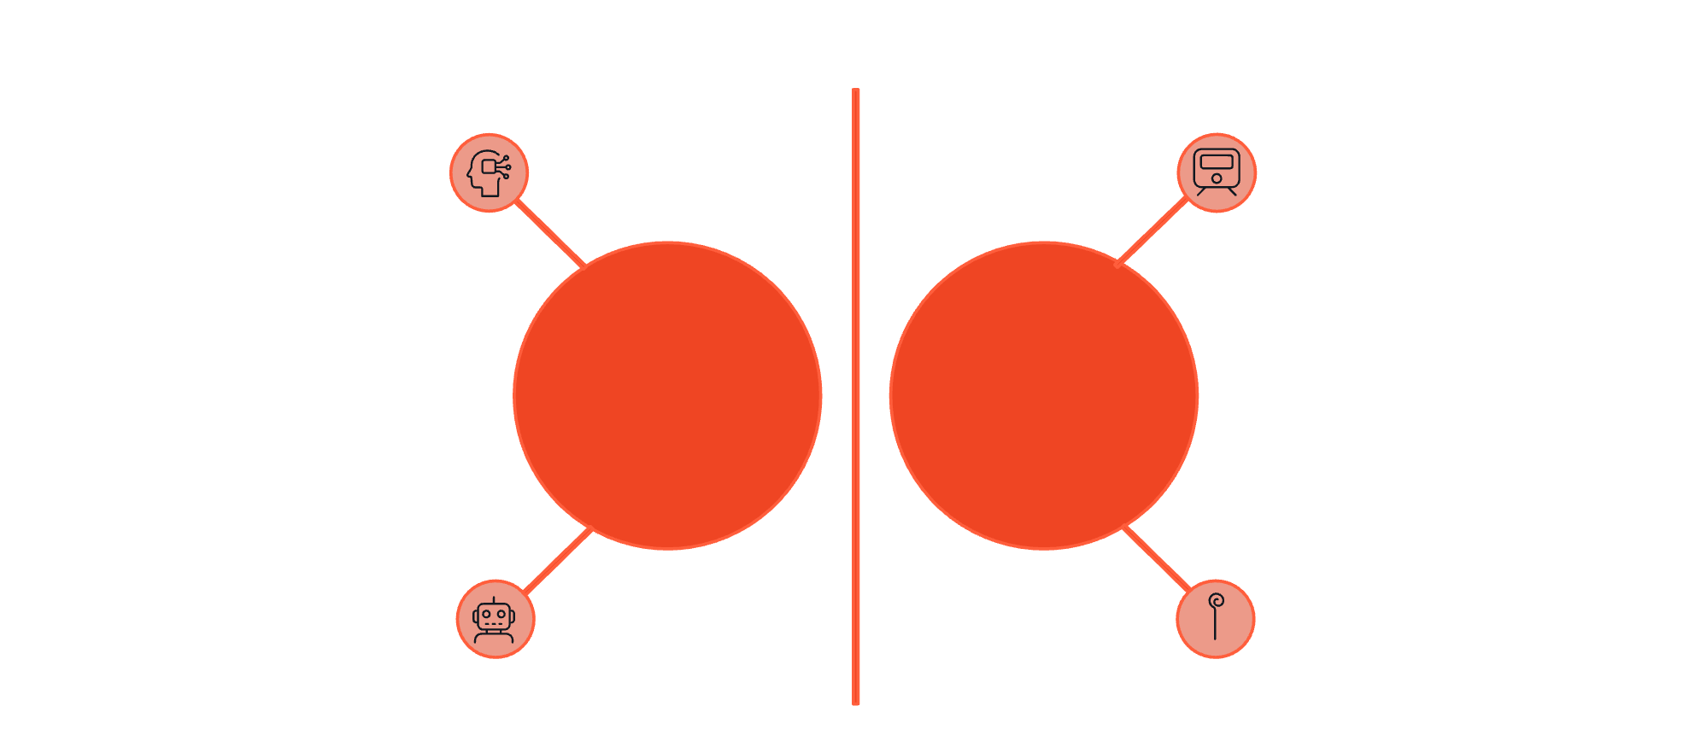




Building a Human-Centric Defence
AI
Training
Technology
Human Behaviour
Automation
Culture
Personalised, Relevant, Adaptive

Slide 17






Key Takeaways
Dynamic Risk Management
Human risk requires strategic HRM approach, not static awareness programmes
DEEP Framework
Clear, actionable model for comprehensive human risk management
Integration & AI
Platform connectivity and artificial intelligence are non-negotiable requirements
Business Outcomes
Measurable risk reduction drives tangible business value

Slide 18

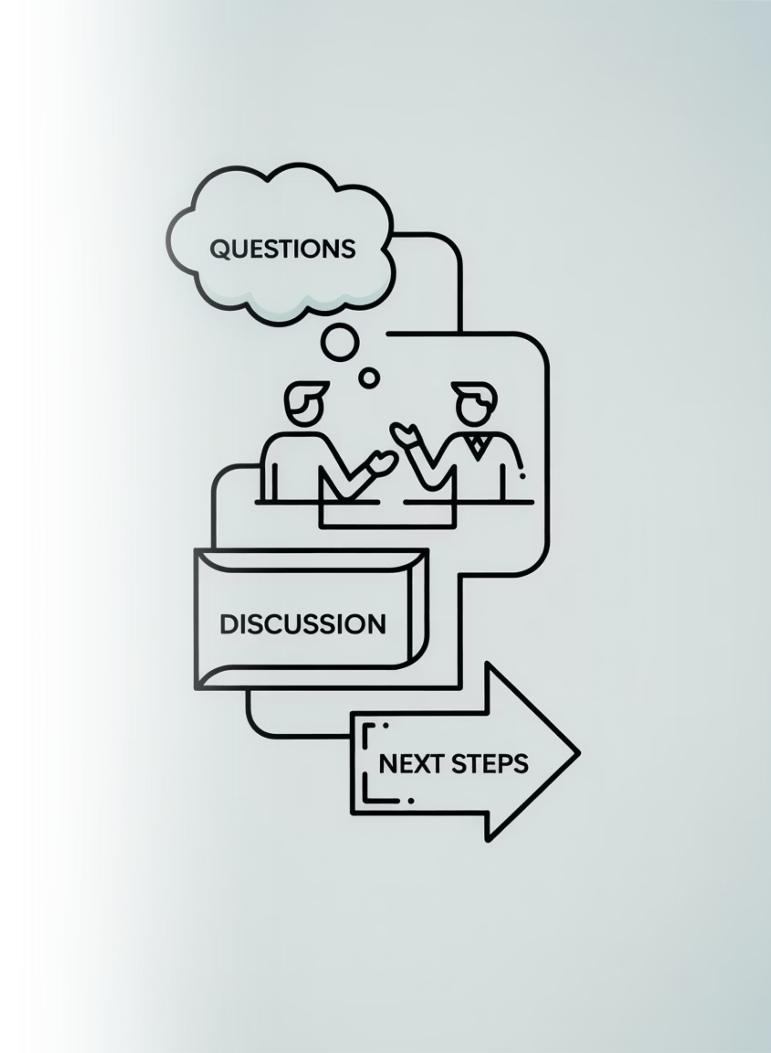
Thank You!
Javvad Malik Lead CISO Advisor
📧 javvadm@knowbe4.com
💼 LinkedIn: /in/javvad

